Slide 1
3107 – JAWAHAR ENGINEERING COLLEGE Subject Title - AI 101- Artificial Intelligence Project Title – Building a Smarter AI Powered Classifier Team Member – 310721205002: S. Muthunivas Pandi
S.No. | NaanMudhalvan ID | Position | Name | Department
 |  | Faculty Mentor | V. Nivaskumar
1. | au310721106001 | Team Head | Junia Susheela Shalom | ECE
2. | au310721205001 | Team member | M. Hariragavan | IT
3. | au310721205002 | Team Member | S. Muthunivas Pandi | IT

Slide 2
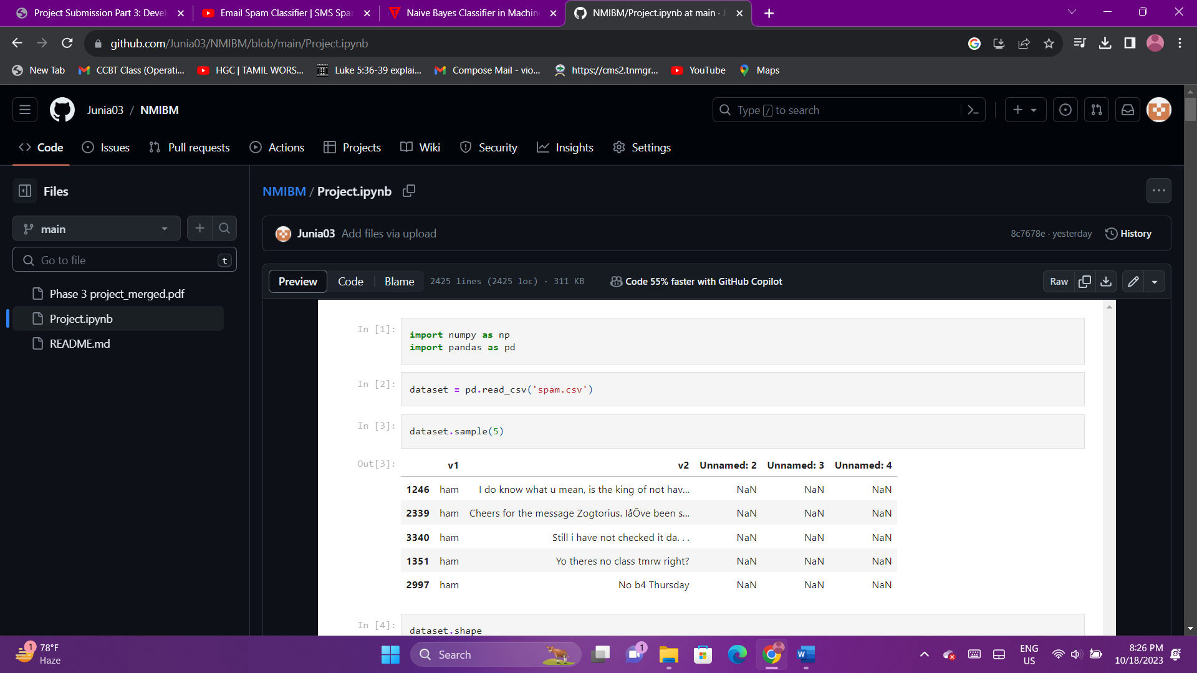
STEP 1: Uploading the CSV file into a Jupyter notebook >First we import the required libraries. >Secondly we open the csv file using the code: dataset = pd.read_csv(‘spam.csv’)

Slide 3
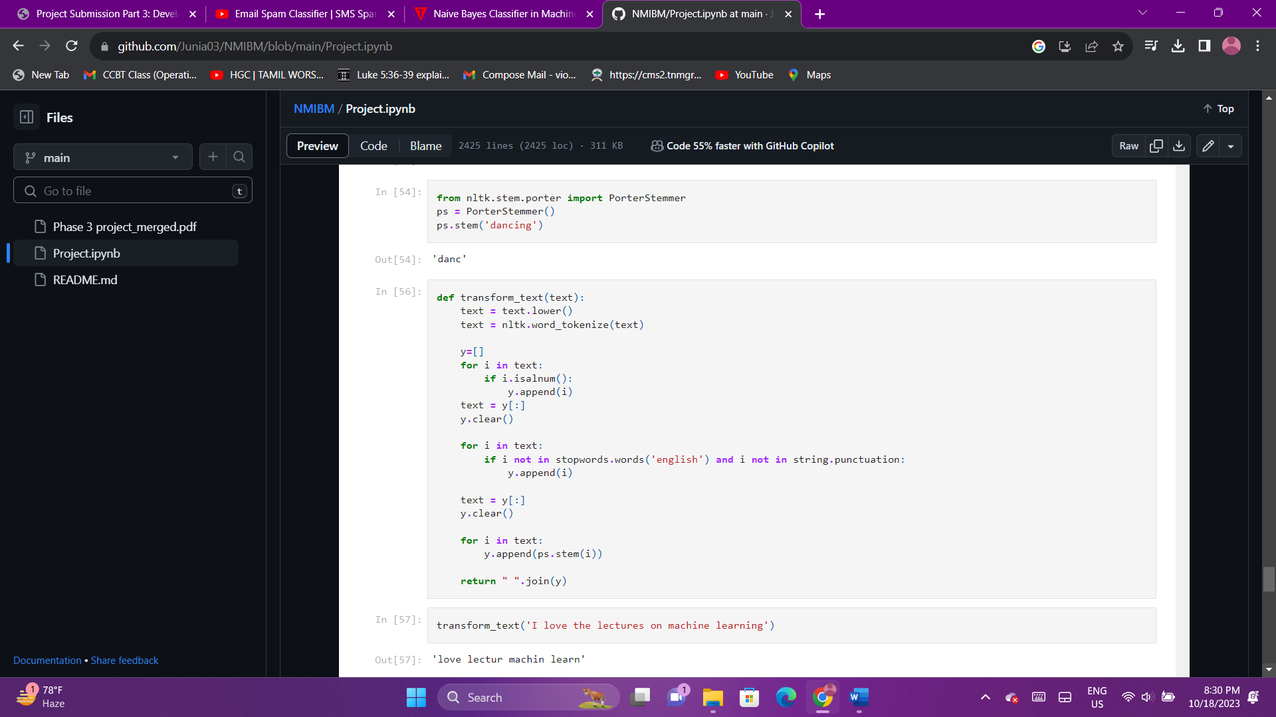
STEP 2: Cleaning the data and preprocessing >First we converting text to lowercase. > Secondly, tokenize the text to individual words. > Then, we remove stop words and punctuation. >Last but not least, implement Lemmatization (that that involves grouping together different inflected forms of the same word). > The above processes are performed using the code shown below:

Slide 4
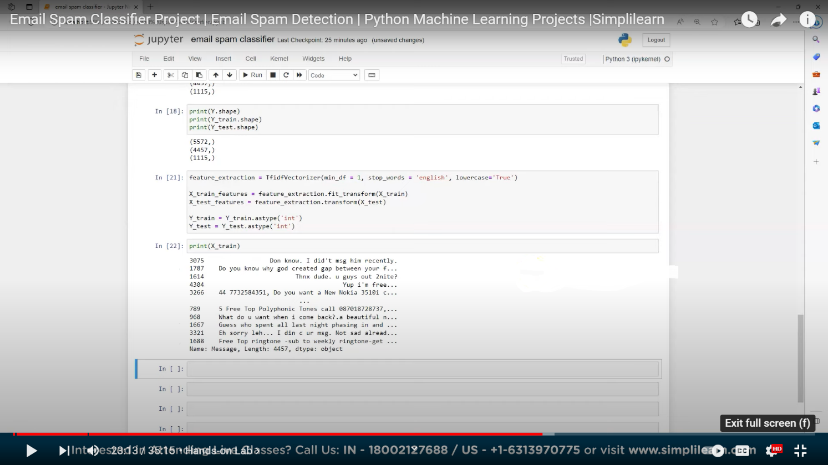
STEP 3: Feature Extraction > This step involves converting tokenized words to numerical features. > Here we use the TF-IDF technique to implement the following lines of code:

Slide 5
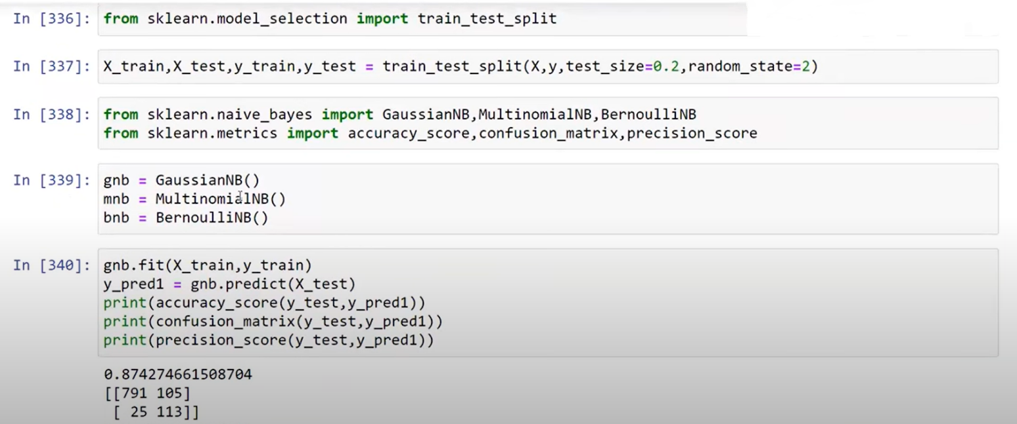
STEP 4: Model Selection > For this project we implement the Naïve Bayes algorithm. > Naïve Bayes algorithm is a supervised learning algorithm, which is based on Bayes Theorem and used for solving classification problems. > The model can trained as follows:

Slide 6
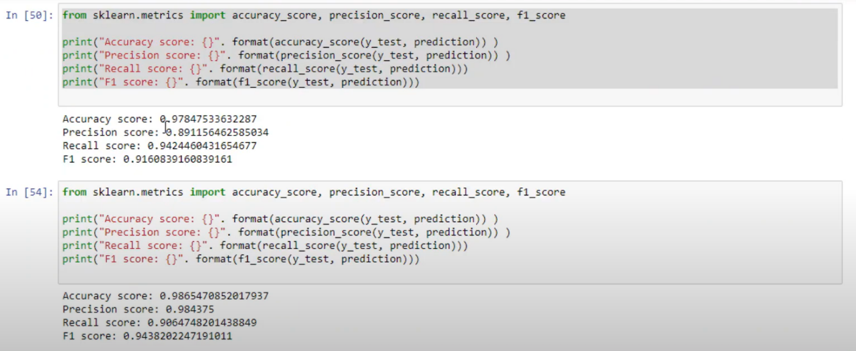
STEP 5: Evaluation and Iterative Improvement of Model > First, we measure the model’s performance using metrics like accuracy, precision, recall, and F1-score, Area under Curve, Confusion Matrix and Mean Square Error. > Secondly, the model is fine-tuned with hyperparameters to improve its accuracy. > The above can be implemented by the following lines of code:

